Slide 1


Access, reuse and long term preservation - some practical tips and advice
Notes:
We’ve looked at some good practice around managing and sharing research data and embracing open science. We want to wrap up this session with a few practical aspects that institutions will need to consider when developing their own services or procuring third party services.

Slide 2
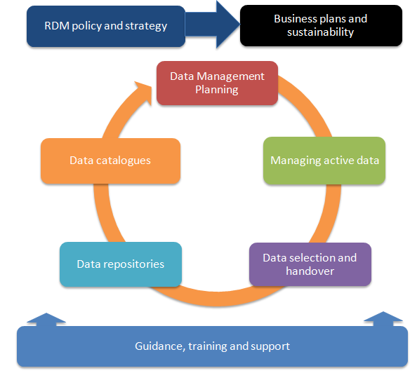
Access, use and preservation services
Scoping, refining, delivering and sustaining RDM services
Practical tips and suggestions
http://www.dcc.ac.uk/resources/developing-rdm-services
http://www.dcc.ac.uk/resources/how-guides
Notes:
In most cases, RDM services are not a single entity but instead are spread across the institution and involve many different operational units. In this respect, it is very difficult to come up with an accurate picture of the RDM as a whole without looking at the individual RDM services to see how costs are incurred and covered across the portfolio of services.

Slide 3
What is the national picture in the UK
Policy and strategy – 87%
Business planning – 13%
Data Management Planning – 50%
Data cataloguing – 38%
Managing active data – 40 %
Data preservation – 18%
Governing access & reuse – 22%
Skills training & consultancy – 63%
% indicating ‘rolling out’ or ‘embedding’
Notes:
To give you an idea of RDM service provision in the UK, here is mapping of the 2015 DCC annual survey. Reflects responses from 60 institutions and is mapped to the DCC RDM services model.
Majority of UK HEIs making good progress in developing training and guidance. Longer term preservation and business case development are proving more difficult across UK HEIs. These will have an impact on training provision as well.

Slide 4
General advice over entire lifecycle

Slide 5
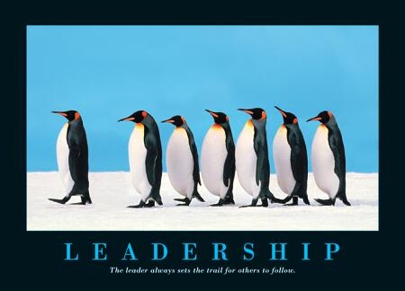
Establish a long term governance group
Good mix of representatives from operational units
Senior management leadership
http://www.executive-coaching-services.co.uk/executive-coaching/leaders.jpg
Notes:
A steering group’s overall goals may include establishing policy principles for RDM, to help communicate where it fits within the organisation’s overall mission, and to define the roles and responsibilities outlined in this guide. The steering group will also devise a strategy or roadmap for high-level approval, considering the institution’s research strategy, external policy drivers, service priorities and technology opportunities. The steering group’s overall goal will be to identify a business case to be presented to whichever organisational body can commit funding towards establishing the necessary services.
It is important to get a good mix of representation from operational units on the working group or steering committee. Representatives from the Library, Research Office, and Information Technology Services are quite common. However, it is good to ensure that you also get representation from:
Ethics Boards to ensure that plans for retaining and sharing data can be recognised within consent forms;
Data Protection/FoI to ensure that expertise on relevant exceptions to data sharing where necessary;
Legal or IPR office staff to ensure that appropriate consortium agreements can be drawn up for collaborations with industry and that appropriate licences can be identified for research output that respect any future plans for commercialisation;
Finance staff to ensure that costing RDM can be effectively addressed in grant applications.
We’d also recommend involving someone from the Archives and/or Records Management. In the UK, they have tended to be overlooked but have a great wealth of knowledge to contribute around retention scheduling, selection and appraisal.
We’ve also found that it may also be beneficial to involve members from different Schools or Faculties to ensure that disciplinary requirements are represented.
However, you may find that not all members need to be involved at all stages. You may start small to get things moving and seek to bring in other stakeholders at relevant points in the process. However, it is advisable to bring in stakeholders before pilot services are developed to ensure that they feel they are part of the process and not simply having solutions forced upon them.
Ideally a member of the senior management group responsible for research should chair the group from the start (e.g. the Vice President or Pro Vice Chancellor for Research). Indeed, it may be a good idea to get more than on senior manager’s backing as it can be quite difficult to maintain momentum of the group if the Pro-VC leaves for any reason. We have seen a few cases where this ha happened in the UK and it can derail activity quite badly if the new Pro-VC doesn’t see RDM as a key issue.

Slide 6
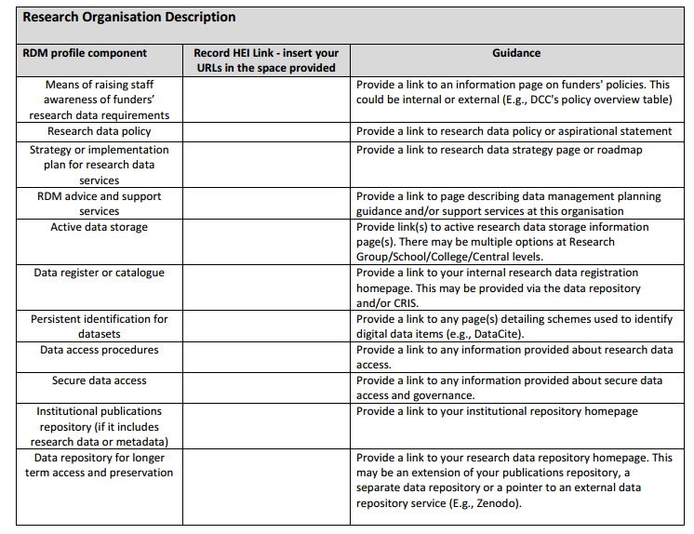
Be aware of existing infrastructure
http://www.dcc.ac.uk/projects/opd-for-rdm
Notes:
It is a good idea to start by undertaking an inventory of your current RDM infrastructure. It is important to be clear here that infrastructure refers to hardware and technical solutions but also to the range of policies, guidance, training and support that are provided within an institution.
Without a clear picture of the infrastructure components already in place and additional components that need to be implemented, it is
likely that inefficiencies or duplication of effort may result when developing RDM services.
We developed a basic RDM profile worksheet and guide as part of the Jisc RDS pilot to extend the Organisational profile Document to cover RDM. The key objective of the RDS pilot project was to agree within the RDM community a list of basic RDM infrastructure components in light of RCUK’s Common Principles on Data Policy and specifically the Engineering and Physical Sciences Research Council (EPSRC) Policy Framework on Research Data and to make these infrastructure components more visible and easier to identify. The first phase of the pilot project ran from March to July 2015. A second phase of the project worked to flesh out a list of questions that HEIs can answer to get a better insight into how they are delivering specific infrastructure components. The second phase ran from September to December 2015.
By developing your own basic RDM profile, you’ll have a better understanding of what infrastructure is in place and how individual components are currently being delivered.
The basic RDM profile should not require much effort to complete. DCC have been using this as a starting point in our engagements recently and it can usually be completed in about half an hour of browsing an institution’s web site. In some cases, resources are restricted to staff only access, but the inventory helps to highlight just how easily services and infrastructure can be found – not necessarily accessed - when a potential customer is looking for it. Some quick wins can be made based on this inventory such as making services more visible and linking to them from more relevant pages that researchers might visit (e.g., not always best to include in the Library pages but rather research pages).

Slide 7
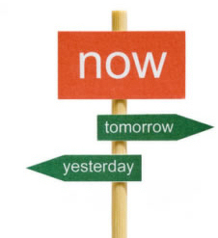

Prioritise requirements
What is urgent?
What can wait?
http://goalsandachievements.co.uk/images/prioritise.jpg
Notes:
Once you’ve identified gaps, consider what is urgently needed and what can wait.

Slide 8
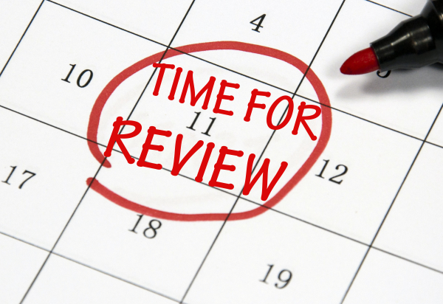
Refining requirements
Requirements change!
Plan to re-assess and refine
http://cdn2.hubspot.net/hub/129398/file-699125079-jpg/images/452070249-resized-600.jpg
Notes:
But remember to monitor how needs are changing over time!

Slide 9
Preserving data

Slide 10
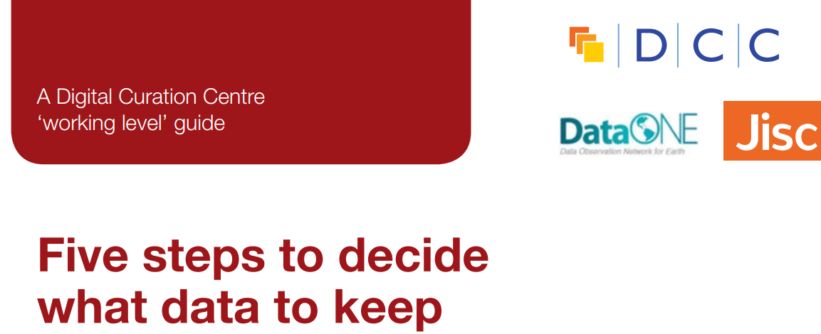
Deciding what data are kept
Initially
  How will access be defined and monitored
  After initial retention period expires
  Will creator be notified of decisions?

Slide 11
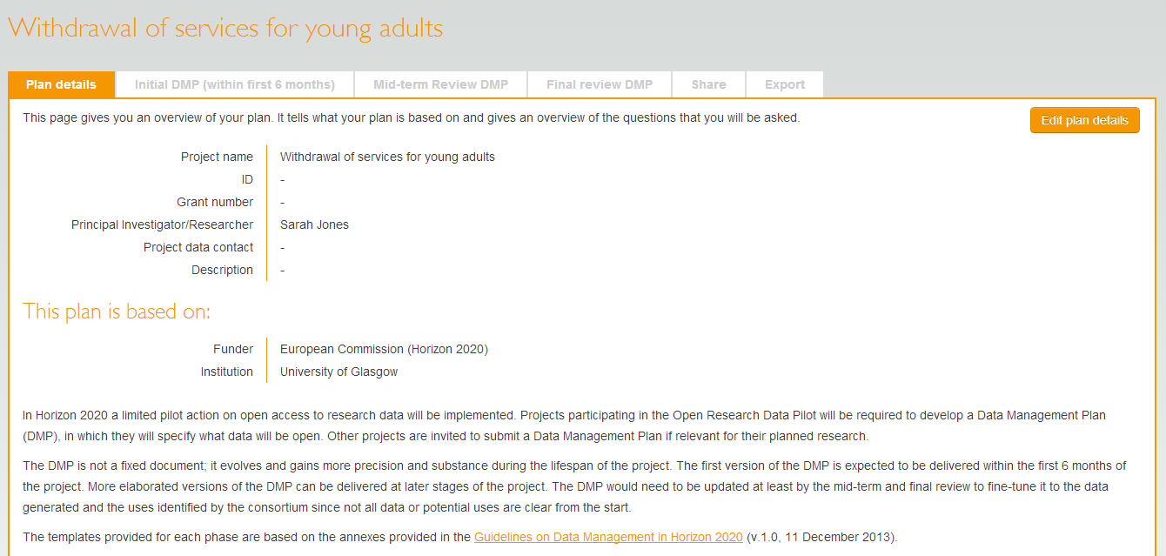
Templates can have multiple phases…
Phases
… but most do not update the DMP throughout the life of the project.
Notes:
Encourage researchers to review their data management plan at least as often as they provide updates to their funder. Consider whether your institutional policy will require researchers to make a final phase DMP public via your institutional repository and link it to you publication and data set. Get them to consider publishing the final version DMP as a data paper – increasing number of peer reviewed data journals emerging. Good to get credit for their efforts!
Most institutions are working with researchers to determine what data needs to be retained at the end of a project to enable reproducibility and to identify any other data that may have longer term value. This can be time consuming as noted earlier. In some cases many hours may be needed to work backwards from publications to data (processes, raw, etc) and considering any software that may need to be retained as well. Up to date DMPs can assist with selection and appraisal decisions and speed up the process significantly and ensure all data that needs to be retained is captured.

Slide 12
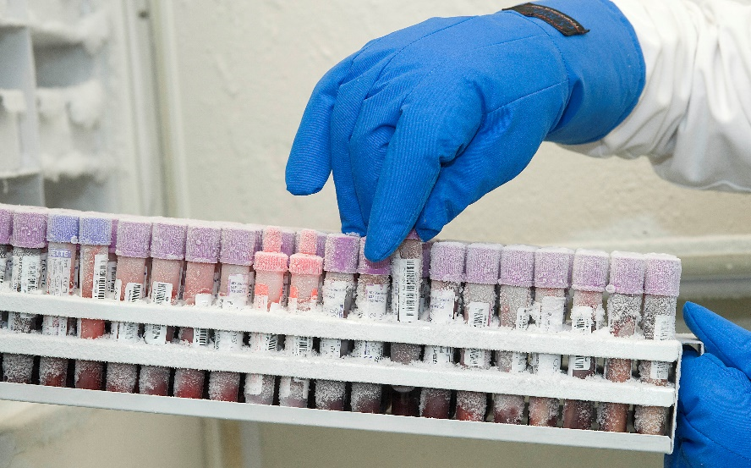
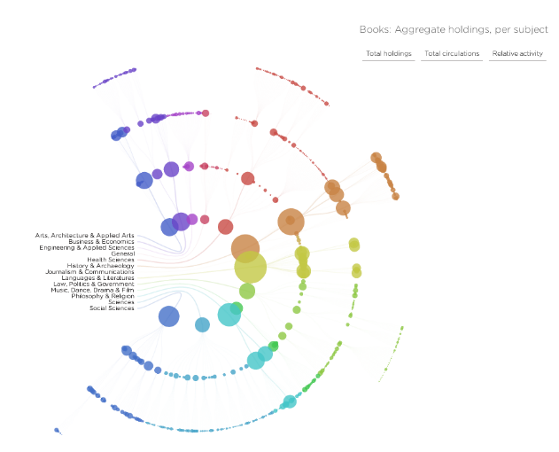
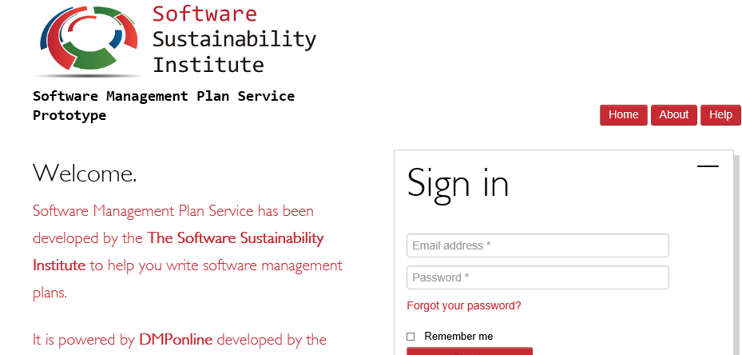
What about physical data, software and models?
http://www.ukcrcexpmed.org.uk/Coventry_Warwick_CRF/PublishingImages/Tissue%20Bank%201.jpg
http://spatialinformationdesignlab.org/project_sites/library/catalog.html
https://ssi-dev.epcc.ed.ac.uk/
Notes:
Maintaining access to data for as long as necessary (usually 10+ years)
Not just the bits!
Consider Github for software and code preservation and if software is a big part of the research activity and possibly leading to a sustained tool or service, consider developing a software management plan (SSI work around DMPonline)
Also consider how links will be maintained between publications, researchers and data.

Slide 13

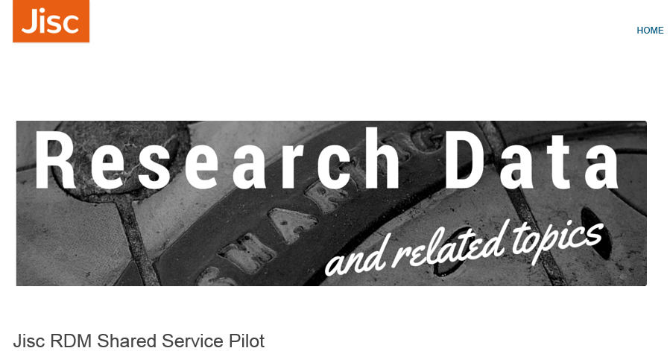
Emerging preservation solutions
http://arkivum.com/about-us/
https://researchdata.jiscinvolve.org/wp/2015/10/07/jisc-rdm-shared-service-pilot/
Notes:
Commercial products starting to emerge
Archivematica
Arkivum
Long term – possibly forever (remember the EPSRC example!)
Not just the bits though – software used to analyse and render data, algorthims used, all part of research reproducibility
Competition as more produce emerge – prices can go down
Know what you need before talking to vendors –speed of access to help determine storage options -worth doing your homework

Slide 14
Discovery, access and reuse

Slide 15
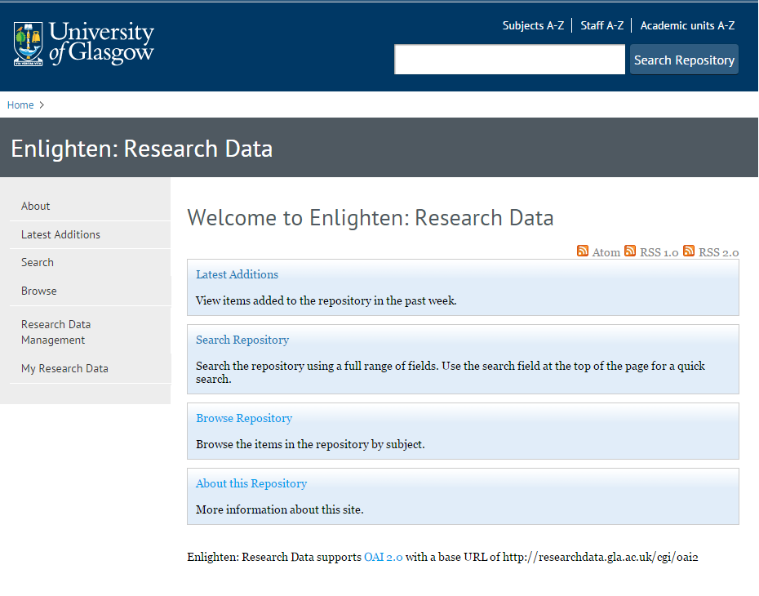
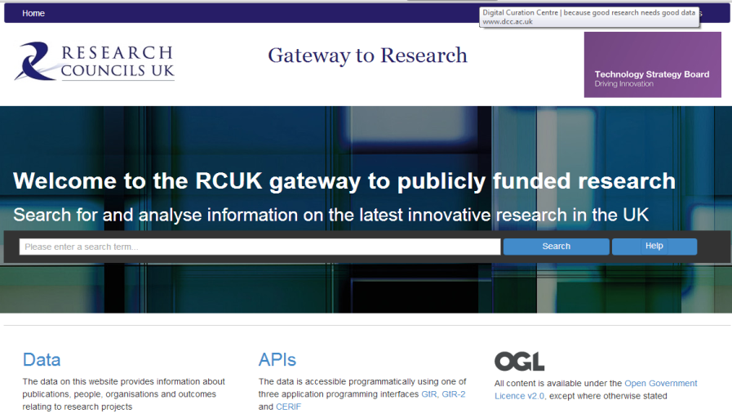
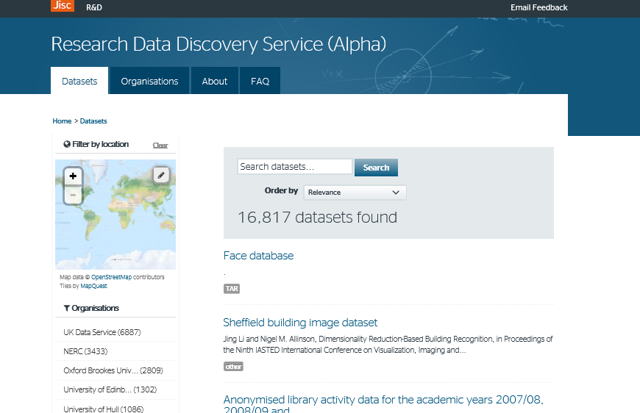
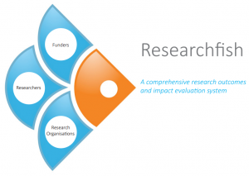
How will you make your data discoverable?
http://gtr.rcuk.ac.uk/
http://researchdata.gla.ac.uk/
https://www.researchfish.com/
http://ckan.data.alpha.jisc.ac.uk/dataset
Notes:
Data reuse depends upon its ability to be found and understood.
Make sure important information can be captured and reused very early on in the lifecycle, For instance, grant information included in research information systems can be repurposed later in the lifecycle by publications and data repositories and ultimately by national aggregators and funders’ outputs systems. Aim to user metadata standards to enable this information to be pushed and pulled between systems. Highlights the importance of applying unique and persistent identifiers Enter one and use many times (CASRAI mantra). Requires adherence to metadata standards and ongoing efforts to enable interoperability among system developers.
Once data has been accessioned into an internal or external data repository, how will usage be monitored? How will you be able to track usage in external systems?
For either internal or external systems, usage will need to be defined as well (download, citation, other?) Most likely monitoring will be automatically handled so this again draws us back to the importance of applying unique and persistent identifiers to research outputs and recommending a preferred citation for datasets. This will make tracking much easier and reporting more straightforward (e.g., for specific funders, for specific researchers, for specific projects)
If monitoring usage, will you use these to help reappraise data? Reuse metrics in one discipline may be far greater than for others so may not be able to have a one size fits all (relate metrics to discipline specific norms)
If the institution is the owner of the data (be clear on this in your policies!), you may not need to inform anyone else of any future decisions around retention. However, it could be good practice to notify content creators of any decisions to remove data from preservation storage so that they may find alternative storage options. Many researchers build upon work for their entire careers so even if it isn’t being widely used by others, it will be of immense importance to their careers.
Also consider how you might handle staff moving to new institutions. They may want to take their data. If the institution owns the data and wishes to retain it, this is where ORCIDs can be incredibly useful. Authors can remain linked to outputs even if their location of work changes. Again, this highlights the value in using standard identifiers.

Slide 16
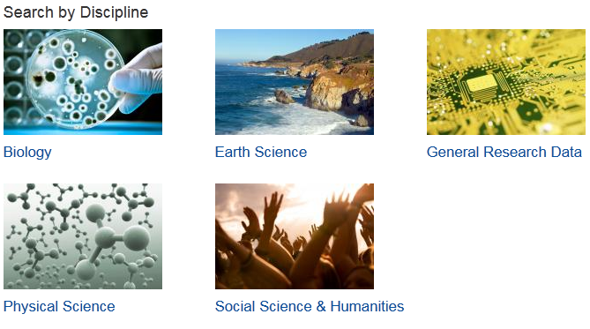
How should you describe your data?
http://www.dcc.ac.uk/resources/metadata-standards
Notes:
To give your data the best chance of being reused, make sure potential reusers can understand it. Use an existing standard whenever possible (almost always!)
DCC’s metadata catalogue can help you find discipline specific standards to use. But remember that interdisciplinarity is a key objective for many institutions and funders are also very keen on this aspect. So, in addition to using disciplinary standards for describing data, consider any information that might be needed for other communities to make sense of the data.
Supporting researchers to develop lay summaries is a great idea. Not only will this help to make their data clear to potential reusers from any discipline, a lay summary is also great to provide to your institution’s communication team for engaging with policy makers and the media.

Slide 17

Practical issues relating to access
How will data access be governed
How will a description of sensitive data holdings be found?
Do you need a safe haven to provide access if requests come in?
Notes:
Open data that can be found and accessed using web interface will not require any additional manual effort in most cases. However, for any retained data that is sensitive – either for commercial reasons or due to the personal nature of the information – will need some mechanism in place where queries requiring access can be received, logged and dealt with.
The formation of a data access group or committee will be necessary to ensure that applications for data access can be assessed and appropriate means of facilitating access can be agreed. In some cases, there may be a safe haven where this can be handled virtually but in most cases this may require agreements and data transfer or in some cases only providing access on site within a secure environment.
To make the burden on data access committee making decisions, as much information about consent and consortium agreements in place – and for how long – is essential. Depends upon good data management planning and documentation.

Slide 18

Make dealing with sensitive data easier from the start
  PI/researcher
  Data repository
  Support staff
  Research participants
  Commercial partners
  Secondary data user
Notes:
During the early stage of the research lifecycle, it is essential to identify any sensitivity issues – either through commercial
While the researchers themselves will have a key role to play in sharing data, it is important to note that they are not the only stakeholders involved in the process.
Repository – how will data be made visible?
Support staff – e.g., Library staff to help describe data to make it easier to find and understand.
Research participants – informed consent is required (come back to this later)
Secondary user – when sharing data, researchers can ask reusers to tick that they accept terms and conditions regarding fair use
Commercial – identify what can and can’t be shared and make this explicit.

Slide 19
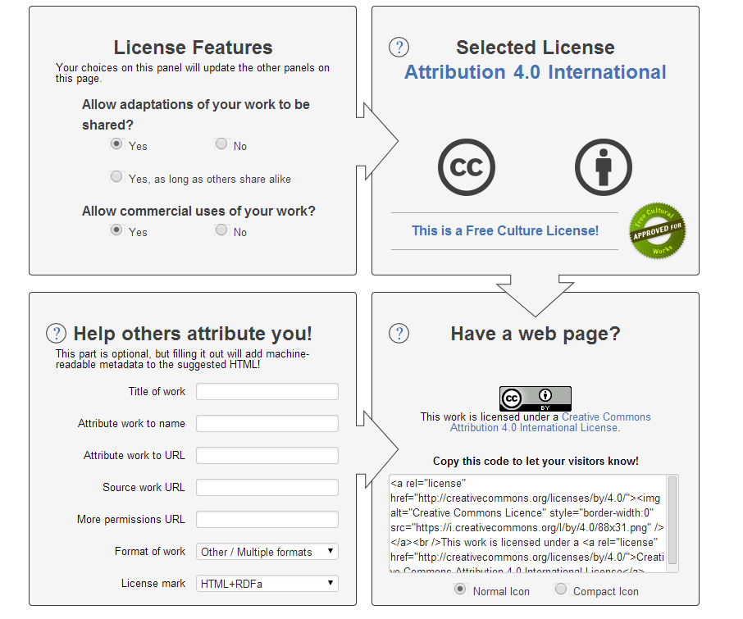
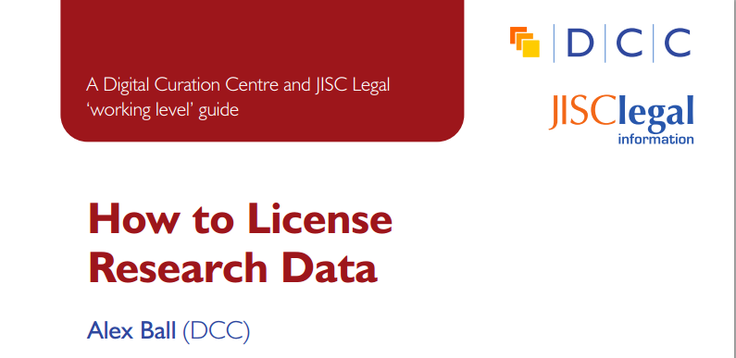
Be clear about who can use data – apply a license
www.dcc.ac.uk/resources/how-guides/license-research-data
http://creativecommons.org/choose/

Slide 20
Sustaining services and infrastructure

Slide 21
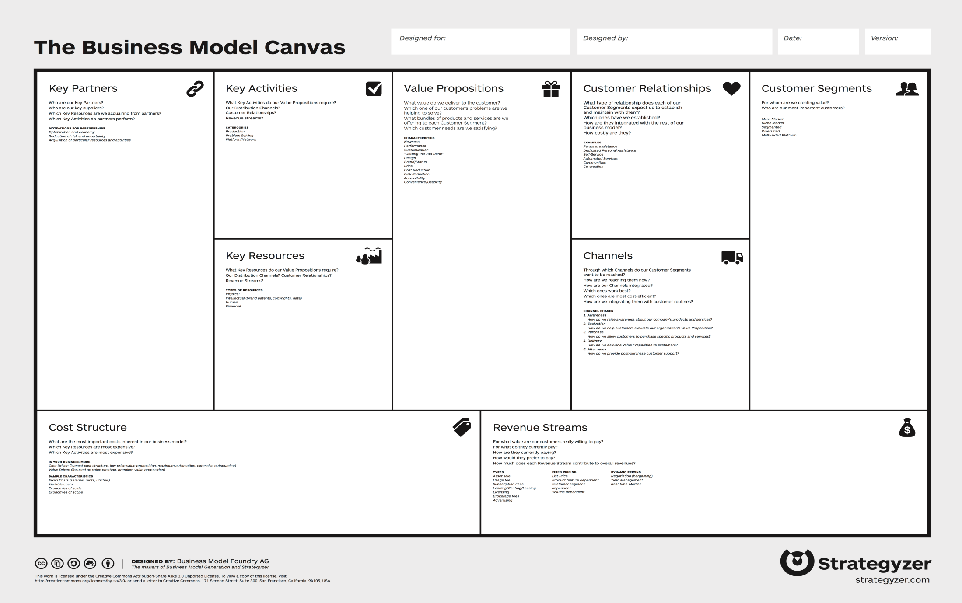
Making the business case for RDM and preservation
Notes:
All of the issues described previously require effort and staff time. Resource is needed to sustain these services over time. To make an effective business cases, consider

Slide 22
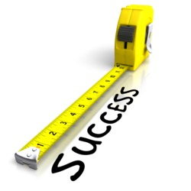
Defining metrics
What should we measure?
How do we measure it?
http://blog.kksmarts.com/wp-content/uploads/2013/05/tape_measuring_success_6539.jpg

Slide 23
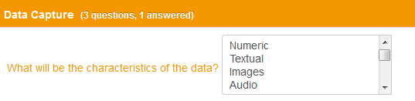
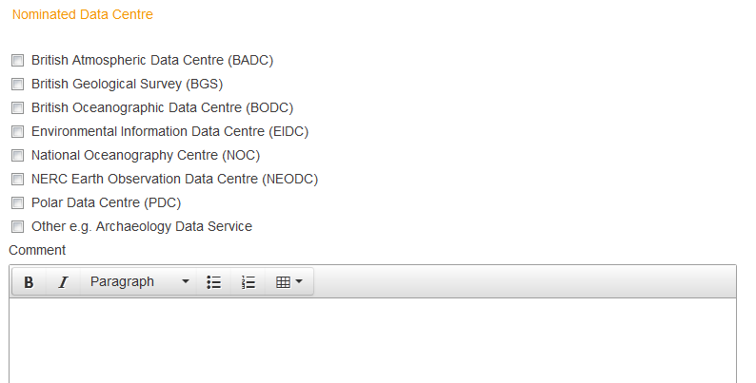
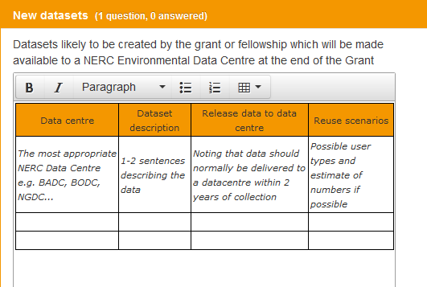
Gaining business intelligence through RDM services
Notes:
Once you’ce considered some of the metrics you’d like to capture, this about how you might be able to build these into other RDM systems and infrastructure. Think about what sort of information you might want/need to report on. Volume, formats, sensitivity of data.
A structured approach to developing an institutional DMP termplate can be particularly useful if you are planning to mine and analyse the information held within data management plans to inform further RDM infrastructure development.

Slide 24
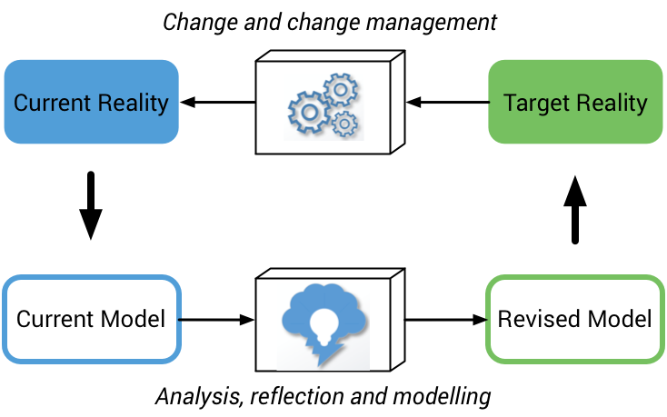
Sustainability of your business model
http://www.curationexchange.org/
Notes:
Keep in mind that the business model you use now is unlikely to remain a perfect fit for your organisation over the longer term. Changes in legislation, evolving stakeholder needs, and potential new revenue streams necessitate the ongoing evaluation and refinement of your business model to ensure that your operations remain viable over time.
It is important to set aside time and effort to actively monitor your business model. By doing so you put yourself in a better position both to respond in a more agile manner to evolving organisational context and stakeholder needs, and to reassess how you deliver services and activities in the face of evolving resources and cost drivers.

Slide 25
Summing up
Understand your organisational context
User requirements need to be gathered and refined over time for each user community
Balance your service offer against resources available and strategic objectives
Re-assess scope as you roll out pilot services - learn through your own experience and from your peers
Plan to review and revise business model over time

Slide 26

Thanks for listening!
DCC guidance, tools and case studies:
www.dcc.ac.uk/resources
Follow us on twitter:
@digitalcuration and #ukdcc

